Slide 1

Event Sync
JG University | BCA – Semester 5 | Division-E

Slide 2
Team Members
Krish Gohil (1416)
Harsh Darji (1417)
Ikrama kathiyara (1426)
Rudra Padhiyar (1437)
Fahad Shaikh (1452)

Slide 3
Introduction
EventSync is a web-based event management system designed to simplify the process of managing, scheduling, and tracking event venue bookings.
The system provides a structured and secure platform for users to create accounts, log in, and interact with event-related services.

Slide 4
Objectives
Simplify Venue Booking
Automate Administrative Tasks
Centralize Event Management
Improve Customer Experience
Improve Communication via Notifications

Slide 5
Existing System
Organizing events such as weddings or birthdays involves multiple tasks like registration, venue booking, scheduling, and communication with participants.
When these activities are managed manually , it often leads to errors , time delays , miscommunication , and data loss.
Drawback of Existing System :
Manual record keeping prone to errors.
Lack of centralized user authentication.
Difficulty in managing event data securely.
Limited scalability and adaptability to different use cases.
MAJOR: INTERIOR DESIGN

Slide 6
Proposed System
The proposed EventSync system overcomes these limitations by offering a secure, scalable, and centralized platform for event management.
Using modern web technologies, the system ensures smooth interaction between users and administrators, while maintaining data security with password encryption and database integration.
Features :
User registration and authentication
Venue Booking
Centralized booking management and scheduling
Database-driven design with MySql
Role-Based Access
Responsive and accessible web interface
MAJOR: INTERIOR DESIGN

Slide 7
System Users
The system is primarily designed for two categories of users :
Administrators
Regular Users
.
Role of Users :
.
Administrators - Manages users, monitors activities, and oversees the overall event process.
Registered Users - Can log in, view, and manage personal event activities.
MAJOR: INTERIOR DESIGN

Slide 8
Modules & Sub Modules
1. User Module:
User registration
Login/logout
Book Venues
Make Payment
Session management.
2. Database Module
Create and update bookings
Event scheduling
Event tracking.
3. Admin Module
User Management
Venue Management
MAJOR: INTERIOR DESIGN

Slide 9
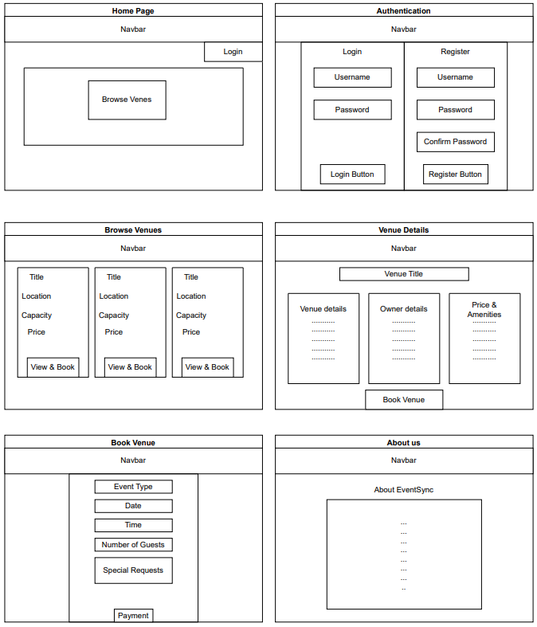
System Design
(Wireframe)

Slide 10
Data Dictionary
Users
User_id | INT | NOT_NULL | PRIMARY_KEY | Unique identifier for each user.
Userame | VARCHAR(100) | NOT_NULL | - | Userame of the user.
Email | VARCHAR(255) | NOT_NULL | UNIQUE | Unique email address.
Password | VARCHAR(255) | NOT_NULL | - | Encrypted User Password.
Full_Name | VARCHAR(200) |  | - | Full Name of the user.
Phone | VARCHAR(10) |  | - | Contact Number of the user.
Address | VARCHAR(300) |  | - | Address of the user.
Role | ENUM(‘user’ ,‘admin’) |  | DEFAULT(‘user’) | Defines User Role(User,Admin).
Created_At | TIMESTAMP |  | DEFAULT(CURRENT_TIMESTAMP) | Record Creation Timestamp.
Updated_At | TIMESTAMP |  | DEFAULT(CURRENT_TIMESTAMP) | Record update Timestamp
MAJOR: INTERIOR DESIGN

Slide 11
ContactMessages
Contactmessage_id | INT | NOT_NULL | PRIMARY_KEY | Unique identifier for each contact message.
user_id | INT | NOT_NULL | FOREIGN_KEY User(User_id) | ID of the user who contacted
Name | VARCHAR(100) | NOT_NULL | - | Name of the person sending the message.
Message | TEXT | NOT_NULL | - | The actual message content.
Created_At | TIMESTAMP |  | DEFAULT(CURRENT_TIMESTAMP) | Timestamp when the message was created (Default = Current time)
MAJOR: INTERIOR DESIGN

Slide 12
Bookings
Booking_id | INT | NOT_NULL | PRIMARY_KEY | Unique ID for each booking.
User_id | INT | NOT_NULL | FOREIGN_KEY User(User_id) | ID of the user who made the booking (foreign key).
Venue_id | INT | NOT_NULL | FOREIGN_KEY Venue(Venue_id) | ID of the venue being booked (foreign key).
Event_type | ENUM('Wedding', 'Birthday') | NOT_NULL | - | Type of event (Wedding/Birthday).
Event_Date | DATE | NOT_NULL | - | Date of the event.
Event_Time | TIME | NOT_NULL | - | Time of the event.
Guest_Count | INT | NOT_NULL | - | Number of guests expected.
Booking_Status | ENUM('Pending', 'Confirmed', 'Cancelled',) |  | DEFAULT ('Pending') | Current status of booking
Special_Requests | TEXT |  | - | Additional requests from the user.
Total_Amount | DECIMAL(10, 2) | NOT_NULL | - | Total cost of the booking.
Created_at | TIMESTAMP |  | DEFAULT (CURRENT_TIMESTAMP) | Timestamp when the booking record was created.
Updated_at | TIMESTAMP |  | DEFAULT (CURRENT_TIMESTAMP) | Timestamp when the record was last updated.
MAJOR: INTERIOR DESIGN

Slide 13
Venues
Venue_id | INT | NOT_NULL | PRIMARY_KEY | Unique ID for each venue.
Venue_name | VARCHAR(200) | NOT_NULL | - | Name of the venue.
Owner_id | INT | NOT_NULL | FOREIGN_KEY User(User_id) | ID of the user who owns the venue (foreign key).
Location | VARCHAR(300) | NOT_NULL | - | Full address/location of the venue.
City | VARCHAR(100) |  | - | City where the venue is located
State | VARCHAR(100) |  | - | State where the venue is located.
Zip_Code | VARCHAR(20) |  | - | Postal/ZIP code of the venue.
Description | TEXT |  | - | Detailed information about the venue.
Capacity | INT | NOT_NULL | - | Maximum number of guests the venue can hold.
Price_per_event | DECIMAL(10, 2) | NOT_NULL | - | Cost to book the venue for an event.
Image | LONGBLOB |  | - | URLs of venue image
Contact_Name | VARCHAR(200) |  | - | Name of the contact person for the venue.
Contact_Phone | INT |  | - | Phone number of the contact person.
Contact_Email | VARCHAR(200) |  | - | Email of the contact person.
Available_Dates | TEXT |  | - | Dates when the venue is available.
Booking_Advance_Days | INT |  | DEFAULT(30 Days) | Days before the event that booking must be made (default 30 Days).
Status | ENUM('active', 'inactive', 'maintenance') |  | DEFAULT ('active’) | Current venue status (active/inactive/maintenance).
Created_at | TIMESTAMP |  | DEFAULT (CURRENT_TIMESTAMP) | Timestamp when the booking record was created.
Updated_at | TIMESTAMP |  | DEFAULT (CURRENT_TIMESTAMP) | Timestamp when the record was last updated.
MAJOR: INTERIOR DESIGN

Slide 14
Payments
Payment_id | INT | NOT_NULL | PRIMARY_KEY | Unique ID for each payment.
Booking_id | INT | NOT_NULL | FOREIGN KEY Booking(booking_id) | Links payment to a booking (foreign key).
Payment_method | ENUM('Credit_card', 'Debit_card', 'Net_banking', 'UPI') |  | DEFAULT ('Credit_card') | Mode of payment used (Credit card, UPI, etc.).
Payment_status | ENUM('Pending', 'Completed', 'Failed', 'Refunded') |  | DEFAULT ('Pending') | Current state of payment (Pending, Completed, etc.).
Amount | DECIMAL(10, 2) | NOT_NULL | - | Total payment amount.
Transaction_id | VARCHAR(100) |  | - | Unique transaction reference number.
Paid_at | TIMESTAMP |  | - | Time when payment was made.
Created_at | TIMESTAMP |  | DEFAULT (CURRENT_TIMESTAMP) | Record creation timestamp.
Updated_at | TIMESTAMP |  | DEFAULT (CURRENT_TIMESTAMP) | Record update timestamp.
MAJOR: INTERIOR DESIGN

Slide 15
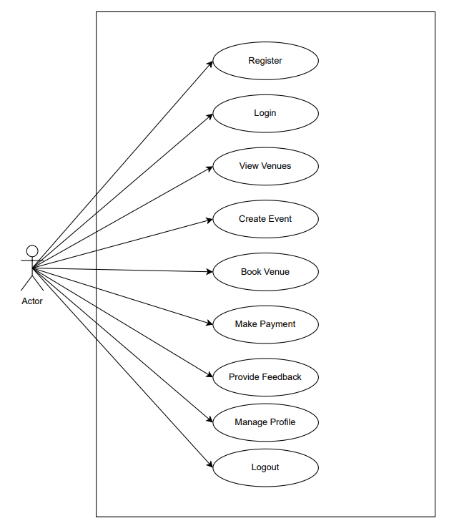
UML Diagrams
Use Case : 1) User Use case

Slide 16
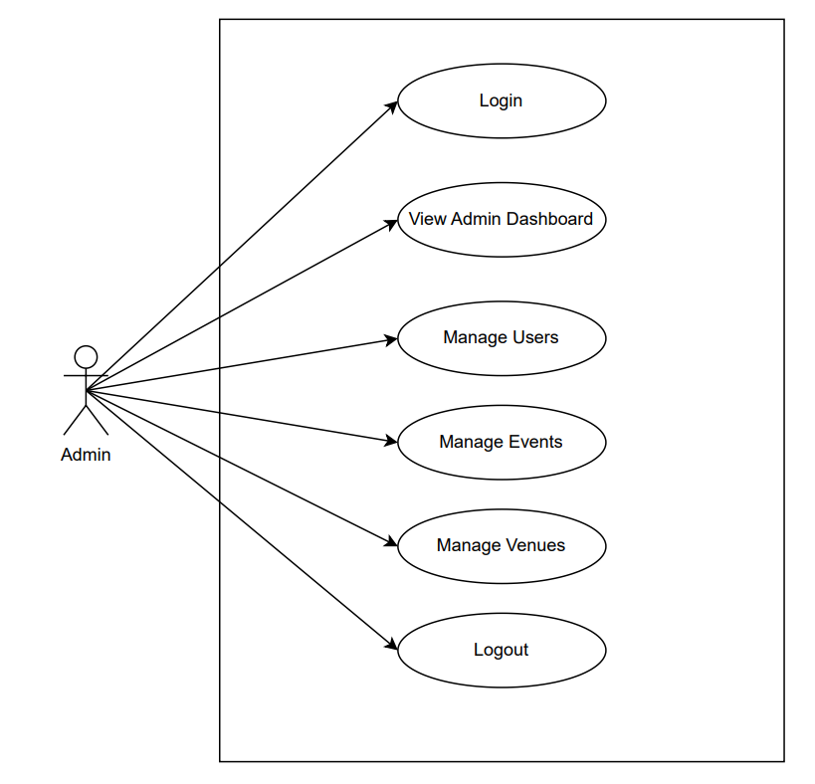
2) Admin Use case

Slide 17
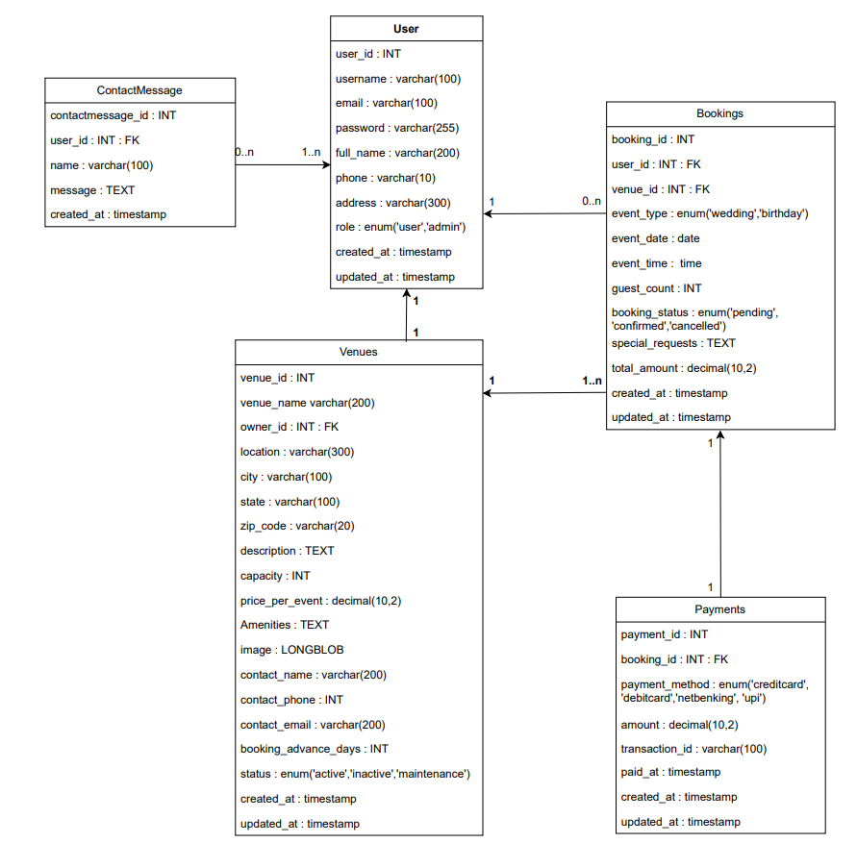
Class Diagram :

Slide 18
THANK YOU

